Slide 1
Analisis Data Geofisika 1
SCGF603501 - Seismic Processing using Seismic Unix

Slide 2
Introduction to Linux
Command prompt
When you login to a system you will be presented with what is referred to as a command prompt.
Example: user@hostname: ~$
user
current directory
machine you are
logged into

Slide 3
Introduction to Linux
Basic File System Functionality
pwd - Print name of current Working Directory.
vandanu@computer: ~$ pwd
/home/vandanu
cd - Change Directory. Changes the current working directory.
vandanu@computer: ~$ cd Devito/devito-env
vandanu@computer: ~/Devito/devito-env$

Slide 4
Introduction to Linux
Basic File System Functionality
which - Which is a command used to locate executables.
vandanu@computer: ~$ which suxwigb
/mnt/d/SU/bin/suxwigb
ls - Displays a listing of files and directories.
useful flags: -l, -a
vandanu@computer: ~$ ls
Devito SeisElastic2D_1.1 SeisUnix devito_project las_converter
...(cont.)

Slide 5
Introduction to Linux
Basic File System Functionality
vandanu@computer: ~$ ls -l
total 20
drwxr-xr-x 5 vandanu vandanu 4096 Aug 14 15:08 Devito
drwxr-xr-x 7 vandanu vandanu 4096 Aug 25 08:46 SeisElastic2D_1.1
drwxr-xr-x 8 vandanu vandanu 4096 Feb 28 15:38 SeisUnix
drwxr-xr-x 3 vandanu vandanu 4096 Aug 14 14:21 devito_project
drwxr-xr-x 5 vandanu vandanu 4096 Mar 8 23:55 las_converter
vandanu@computer: ~$ ls -a
.bash_logout .bashrc .config .gmt .landscape .local .profile .vscode-server Devito SeisUnix las_converter

Slide 6
Introduction to Linux
Basic File System Functionality
mkdir - Creates a new empty directory.
vandanu@computer: ~$ mkdir test
vandanu@computer: ~$ ls
test
cp - Copy a file or directory.
useful flags: -r
vandanu@computer: ~$ cp -r test test_new
vandanu@computer: ~$ ls
test test_new

Slide 7
Introduction to Linux
Basic File System Functionality
mv - Moves or renames a file (actually the same operation in UNIX).
vandanu@computer: ~$ mv test_new test_rename
vandanu@computer: ~$ ls
test test_rename
rm - Removes a file/directory.
useful flags: -r, -f
vandanu@computer: ~$ rm -r test_rename
vandanu@computer: ~$ ls
test

Slide 8
Introduction to Linux
Basic File System Functionality
chmod - Change mode, is a command used to modify permissions on a file. If you would like to share your files with another user in your group, you can modify the permissions to grant read, write, or execute the file.
useful flags:
vandanu@computer: ~$ mv test_new test_rename
vandanu@computer: ~$ ls
test test_rename
u g o + - r w x | (User) (Group) (Other) (Add permission) (Remove permission) (Read) (Write) (Execute) | vandanu@computer: ~$ ls -l -rw-r--r-- 1 vandanu vandanu 32 Aug 28 01:28 test.txt vandanu@computer: ~$ chmod g+rwx test.txt vandanu@computer: ~$ ls -l -rw-rwxr-- 1 vandanu vandanu 32 Aug 28 01:28 test.txt
user
group
other

Slide 9
Introduction to Linux
Basic File System Functionality
chown - Change Owner, is a command used to modify the owner of a file. This usually can only be performed on a system where you have administrative rights and can switch files from one user to another.
chgrp - Change Group, is a command used to modify the group that can read a file. You can only switch group ownerships on a file that you are the owner of.

Slide 10
Introduction to Linux
Basic File System Functionality
Relative Paths and Absolute Paths -> path which is relative to your current working directory, symbolized with single or double dot.
./ (current directory)
../ (one directory up)
Application Paths -> the shell searches directories in the path. Use echo to execute
vandanu@computer: ~$ echo $PATH
vandanu@computer: ~$ /usr/local/sbin:/usr/local/bin:/usr/sbin:
/usr/bin:/sbin:/bin:/usr/games:/usr/local/games:

Slide 11
Introduction to Linux
Text editor
gedit - Graphical text editor with syntax highlighting for lots of languages (Python, Shell, C, Markdown, etc)
vandanu@computer: ~$ gedit
nano - Text-based editor and designed to emulate the functionality and ease-of-use of the UW Pico text editor.
vandanu@computer: ~$ nano

Slide 12
Introduction to Linux
Building an application from source
apt - Linux software is mostly provided by a distribution. Software is arranged into packages and groups of packages. This is kind-a like an "app store", but everything is free and kept up to date by the distribution (On Ubuntu/Debian distributions, use apt)
vandanu@computer: ~$ apt-get python-numpy
--To install, remove, and change in system-level programs requires administrative (root) privileges. Therefore, use "sudo"
vandanu@computer: ~$ sudo apt install gedit

Slide 13
Introduction to Linux
Unix help mechanism- Unix man pages
man - Every program on a Unix or Unix-like system has a system manual page, called a manpage, that gives a terse description of its usage.
vandanu@computer: ~$ man pwd
PWD(1) User Commands PWD(1)
NAME
pwd - print name of current/working directory
SYNOPSIS
pwd [OPTION]...
DESCRIPTION
Print the full filename of the current working directory.

Slide 14
Introduction to Linux
File storage and performance across file systems
For the fastest performance speed, store your files in the WSL file system if you are working in a Linux command line (Ubuntu, OpenSUSE, etc). If you're working in a Windows command line (PowerShell, Command Prompt), store your files in the Windows file system.
-> Linux file system root directory: /home/<user_name>/Project
-> Windows file system root directory: /mnt/c/Users/<user_name>/Project

Slide 15

Introduction to Linux
[Task 1]
1. Download the data from the drive
2. Create a project folder for seismic processing (either in Linux or Windows file system) and check the permissions
3. Move/copy the data from the download path to the project folder
4. Extract the data

Slide 16
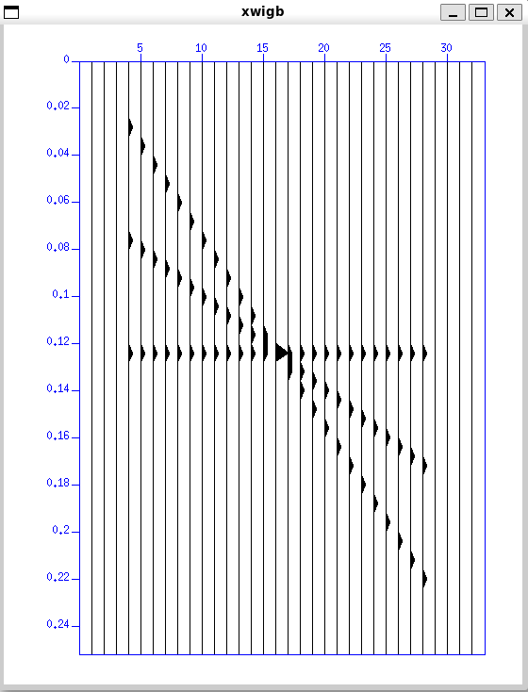
Getting started with Unix and SU
Any SU programs that has executables permissions and which appears on the users' PATH may be run by just simply write out on the commandlines.
$ suplane | suxwigb &
$ suplane | suxwigb title="suplane"
Ampersand symbol
"pipe" symbol

Slide 17
Getting started with Unix and SU
Pipe, redirect in, redirect out, and run in background
Pipe "|", ouput from one program may be pipped out to another program
$ suplane | suspecfx | suxwigb
Redirect out ">", writing output to the file
$ suplane > junk.su
Redirect in "<", reading input from the file
$ suxwigb < junk.su

Slide 18
Activity 1 - Viewing data
The dataset can be accessed here, consisting of 2D land seismic data.
Our data is in SEGY format and need to be converted to SU format.
--> segyread
View the header.
--> surange
Examine the SU header!
tips: type the program to see manual page

Slide 19
Activity 1 - Viewing data
Wiggle traces
--> suxwigb
Image plot
--> suximage
Select key header word to window on. See SU key with description here
--> suwind

Slide 20
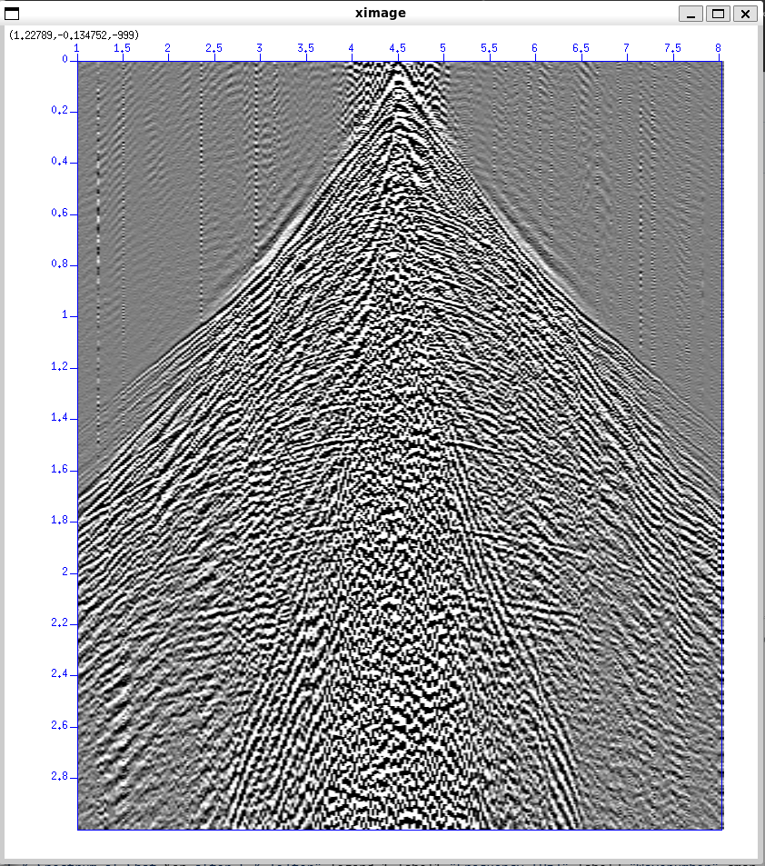
Activity 3 - Filtering
Ground roll removal
Ground roll noise reduction using FK filter (frequency (f) and wavenumber (k) spectrum)
--> sudipfilt
Required parameter: d2 (spatial sampling)
Parameter:
amps=1,1,1,1 (do nothing)
amps=1,0,0,1 (The reject zone)
amps=0,1,1,0 (The pass zone)
--> suximage

